Slide 1

SQL Presto Tech Computer Science Technologies for Big Data Management
SUPERVISOR
Massimo Callisto De Donato
TEAM PEDDIBOINA MOHAN VAMSI VAIBHAV MATHUKIYA

Slide 2
CONTENTS
Project Description & Objectives
Methodology and Technologies
Technical Implementation
Approach
Achieved Results & Conclusion

Slide 3
1. Project Description
SQL Presto Tech
A tool that enables Real-Time Data Analytics on data
from devices IoT devices using technologies such as
Kafka, MongoDB and Presto

Slide 4
Objectives
Messages
Handle and publish messages in real-time on Kafka Topics
Storaging
Store IoT data in a
NoSQL Database
Presto
Study and use Presto’s SQL engine to perform queries on a NoSQL Database
Analytics
Create a tool for analytics

Slide 5
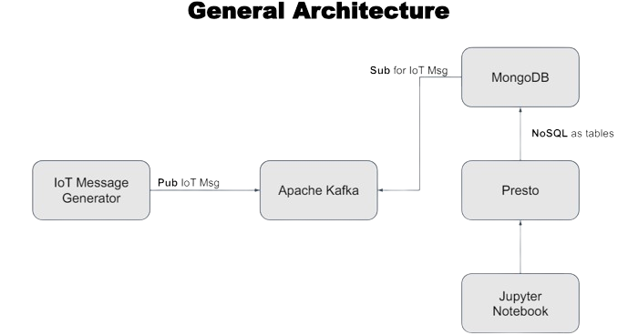
2.Methodologies & Technologies
Power BI

Slide 6




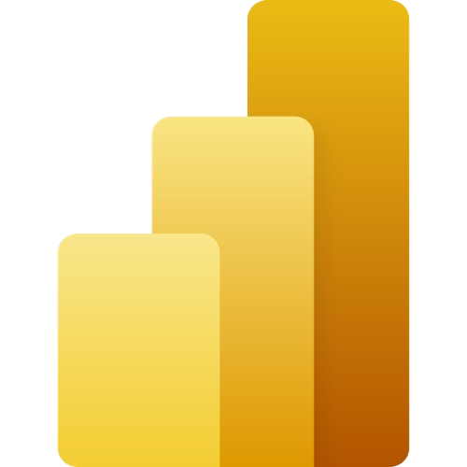
Technologies
Apache Kafka
It is a distributed data streaming platform that can publish, subscribe to, store, and process streams of records in real time.
MongoDB
It is an open source NoSQL database that uses a non-relational,
document-oriented data model to stores data objects
Presto
It is a distributed SQL query engine that is open-source and optimized for
high-speed analytic queries of data of any size.
Power BI
It is a Microsoft business analytics service that enables users to
visualize and share insights from their data through interactive dashboards and reports.

Slide 7
3. Technical Implementation

Slide 8
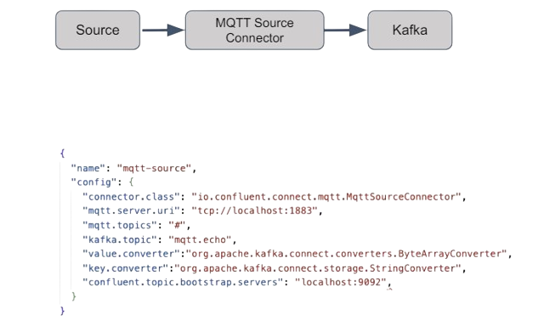
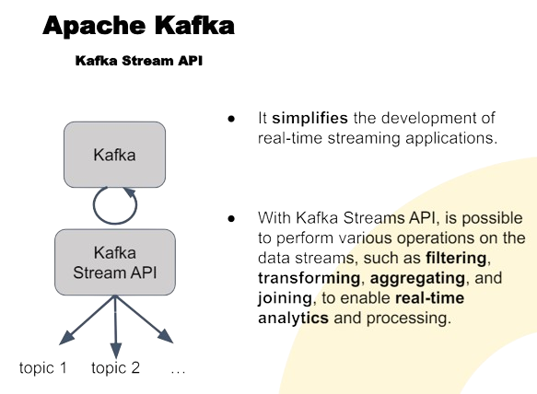
Apache Kafka
A distributed publish-subscribe messaging system used to stream messages that comes from the iot-simulator
In order to stream the messages is needed a MQTT-Source connector that connects to a MQTT broker and subscribes to the specified topics

Slide 9
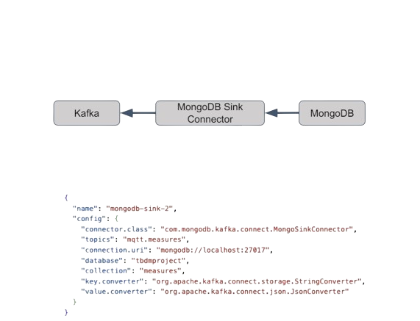
Mongo DB
MongoDB is a document-oriented NoSQL database used to store messages streamed by Kafka.
In order to address messages inside each mongodb collection is necessary to use the MongoDB Sink Connector, that reads data from Apache Kafka topic and writes data to MongoDB

Slide 10
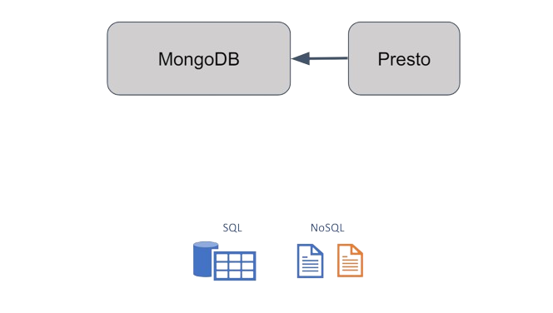
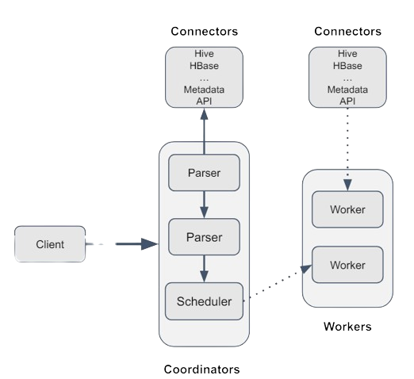
Presto
Presto is a distributed SQL query engine that supports non-relational sources.
That is how Presto allows to perform SQL computation over MongoDB (NoSQL).
Presto architecture

Slide 11
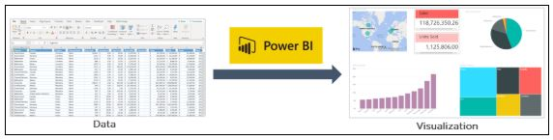
Power BI
It is a Microsoft business analytics service that enables users to visualize and share insights from their data through interactive dashboards and reports.
While the platform is commonly used by business analysts, it is also designed to be easily accessible for those without any specialized data knowledge.

Slide 12
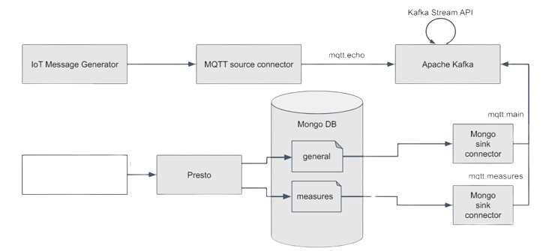
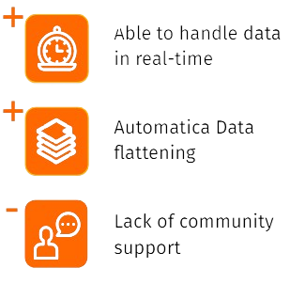
4. Approach
Power BI

Slide 13
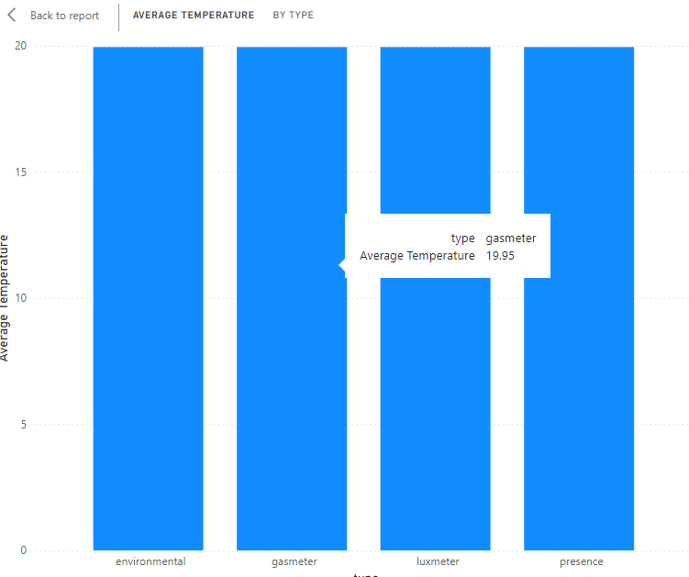
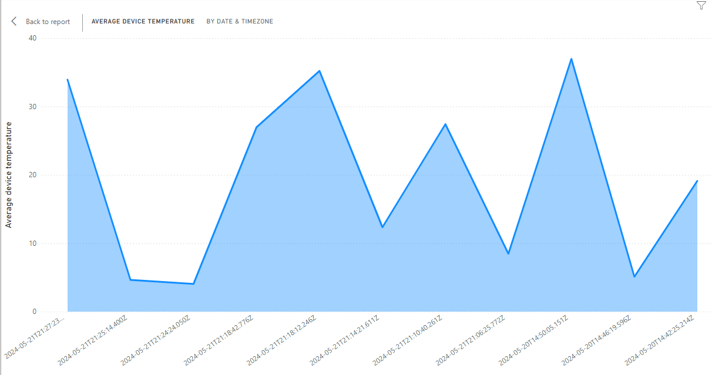
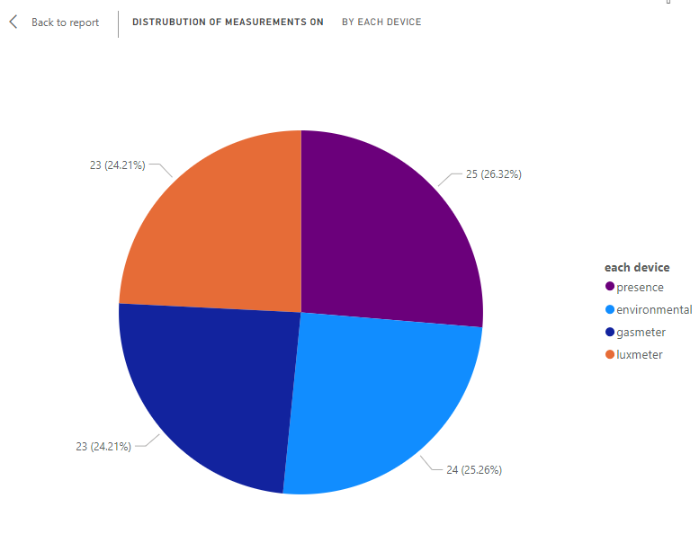
Results
Future implementation
AI and Machine Learning Integration
Advanced Analytics and Visualization
Blockchain for Data Integrity

Slide 14
thank you

